Slide 1
Credit Card Fraud Detection

Slide 2
Introduction & Objective
The objective of this case is to study the given transactions data and analyze it to be able to build a predictive model to accurately predict which credit card transactions are more likely to be fraudulent.
To do so we will be performing some EDA to be able to know which of the feature in hand are better suited to be interduced to our ML algorithem.

Slide 3
Methodology
Data Preprocessing and Feature Engineering:
In this step we have loaded our data and checked for duplicated values or for missing values but there were non.
Then we created new relevant feature called “Time of Day” in which we used the “step” column to get the time of day for each transaction.
After that we have performed one hot encoding to encode our categorical features into numeric before scaling the features.

Slide 4
Methodology
Data Preprocessing and Feature Engineering:
We have dropped the following two columns (“zipcodeOri”, “zipMerchant”) since they have only one value in them. Also, I have dropped the column “merchant” and “customer” since they have too many unique values which will bad for our model after one-hot encoding them.
We also performed data scaling to ensure that all features contribute equally to the model and to avoid the domination of features with larger values.
finally in this phase we’ve split the data to training and testing for our predictive model.

Slide 5
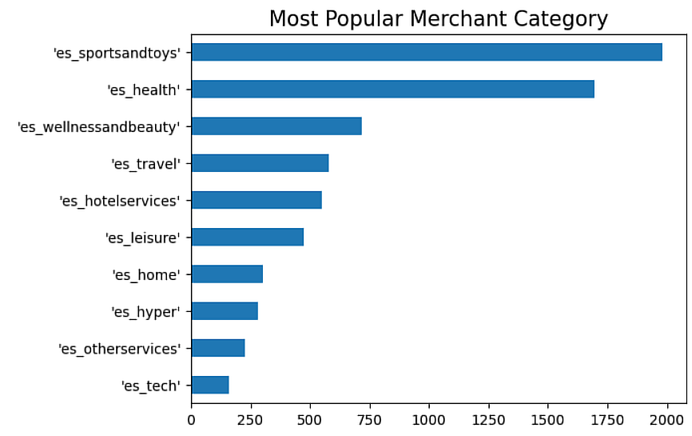
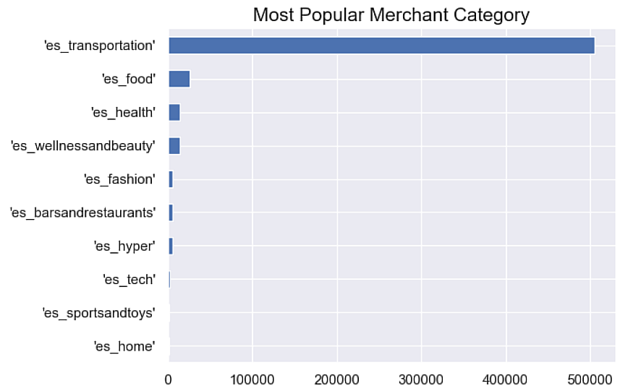
Methodology
Exploratory Data Analysis (EDA):
In this step we have performed some analysis to try and find some unique features or patterns for the fraudulent transactions.
We can see that for the fraudulent transactions the most common Category is “sportsandtoys” meanwhile for non-fraudulent its “transportation”

Slide 6
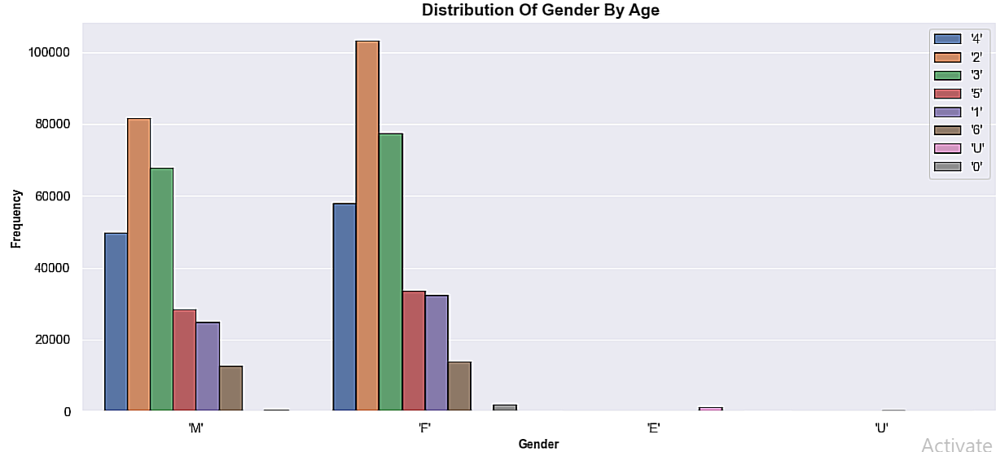
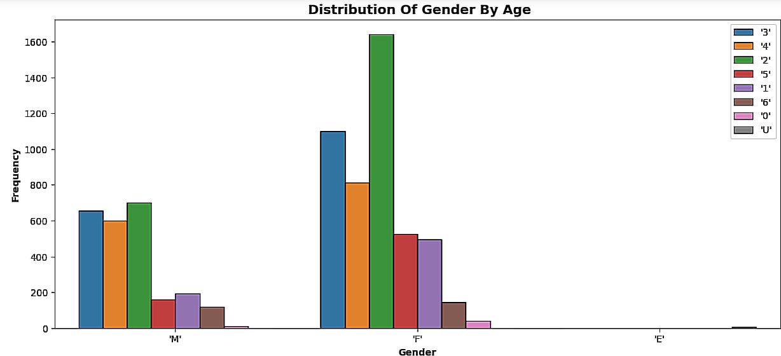
Methodology
Exploratory Data Analysis (EDA):
As another example here we found that males of all ages have more non-fraudulent transactions then females.
But females from the ages of 26 to 45 have the most fraudulent transactions.

Slide 7
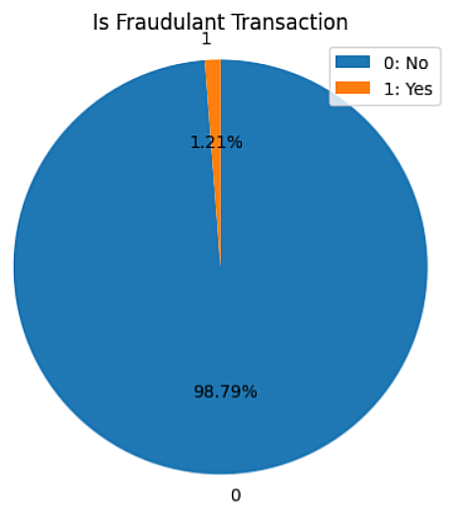
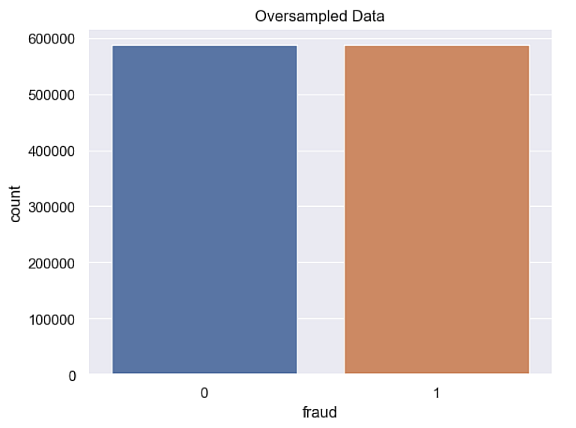
Methodology
Handling Imbalanced data (Oversampling):
We saw that we have a very big data imbalance. One of the ways that can be used to fix this problem is Oversampling.
Oversampling might give better results as there is no loss of information unlike Under sampling.

Slide 8
Methodology
Model Selection, Training, Tuning, and Testing:
For this case I have decided to build a voting classifier model using for models(XGBoost, AdaBoost, Random Forest, Logistic Regression).
Regarding the training and Tuning of the XGBoost and Random Forest models the hyperparameter tuning was done by choosing random values and then working from there to reach a good model.
For the AdaBoost model I have used GridSearchCV to tune the hyperparameters then used the best parameters to build the model.
Regarding the logistic Regression model, I kept all the default values for the hyperparameters.
I used this combination of tuning methods and models in the voting classifier because when one model can be biased towards one feature the voting classifier will derive a generalized fit of all the individual models.

Slide 9
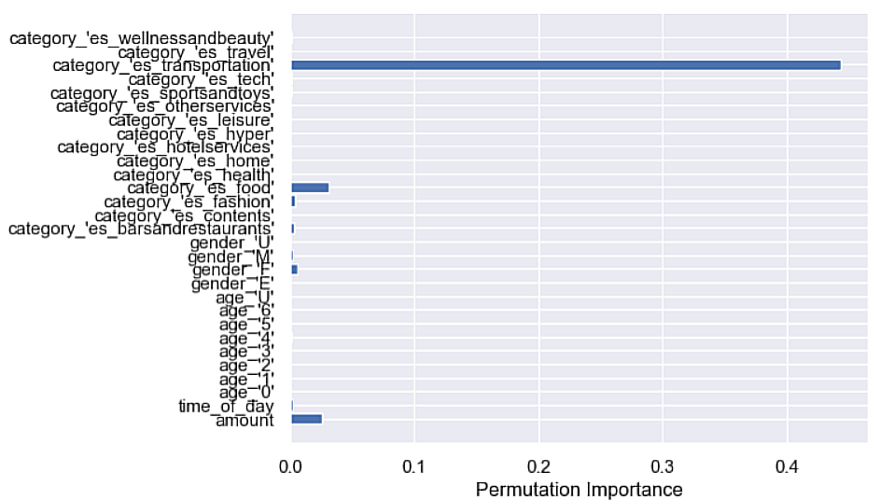
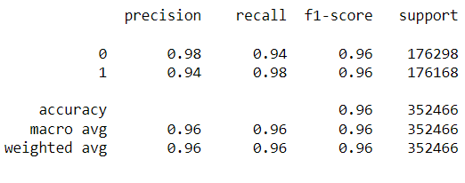
Methodology
Model Evaluation & Interpretation:
Comparing each individual model, I noted that they have very close scores but what distinguish them from each other is the feature importance for each one of them.
The following shows the scores and feature importance of each model
XGBoost:

Slide 10
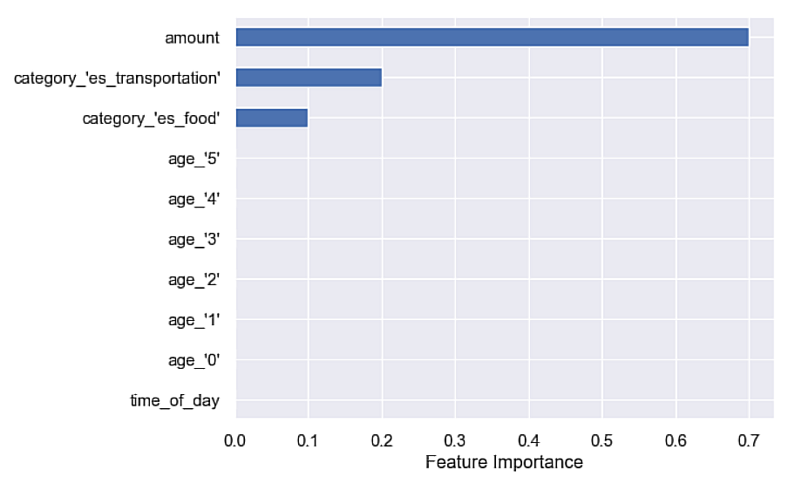
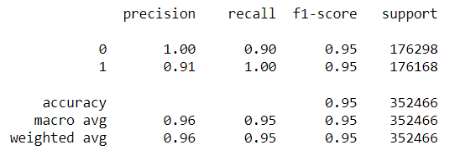
Methodology
Model Evaluation & Interpretation:
Comparing each individual model, I noted that they have very close scores but what distinguish them from each other is the feature importance for each one of them.
The following shows the scores and feature importance of each model
AdaBoost:

Slide 11
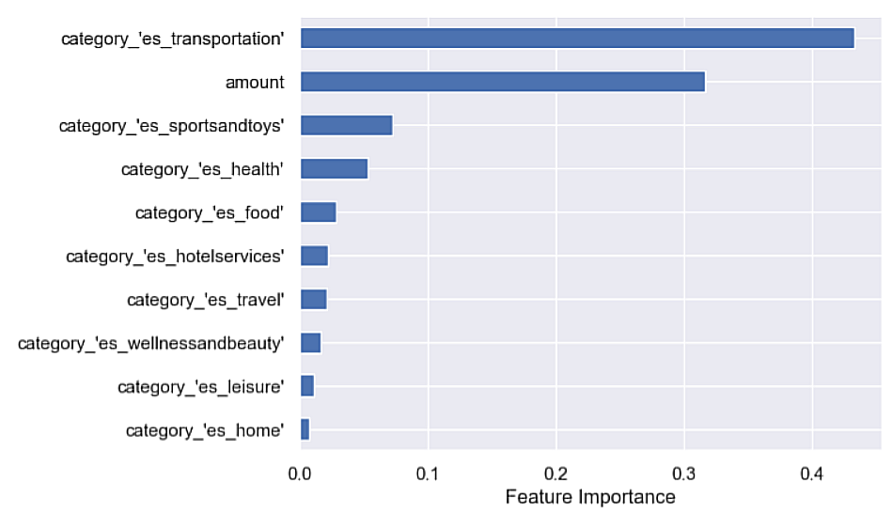
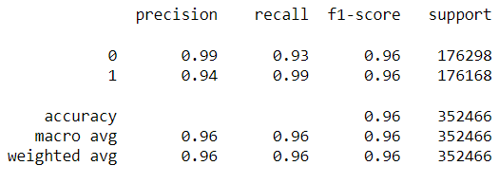
Methodology
Model Evaluation & Interpretation:
Comparing each individual model, I noted that they have very close scores but what distinguish them from each other is the feature importance for each one of them.
The following shows the scores and feature importance of each model
Random Forest:

Slide 12
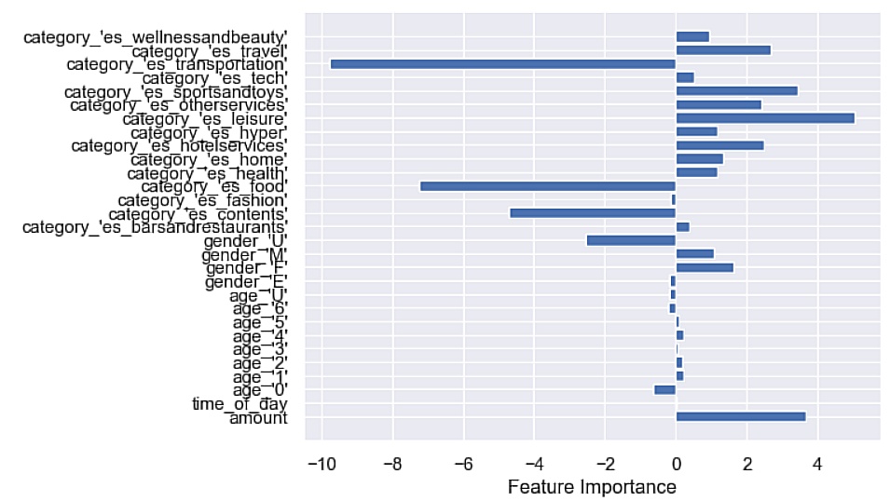
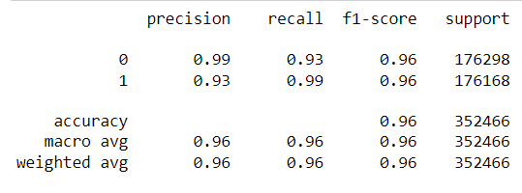
Methodology
Model Evaluation & Interpretation:
Comparing each individual model, I noted that they have very close scores but what distinguish them from each other is the feature importance for each one of them.
The following shows the scores and feature importance of each model
Logistic Regression:

Slide 13
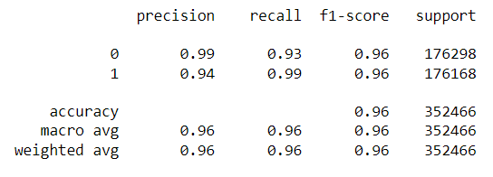
Methodology
Model Evaluation & Interpretation:
For the Voting Classifier these were the following metrics:

Slide 14
Recommendations and Key Outcomes
The categories and merchants at which is a transaction is labeled fraudulent should be monitored to make sure if those transactions are fraudulent.
Check if those transactions keeps occurring at a specified time or with a specified amount.
Keep track of the customers whose transactions are labeled fraudulent. do they keep making transactions at the same merchant regularly with the same amount or time.
Deploy the model for a month or two to check its prediction. is it valid or does the model needs retraining.

